Slide 1


Part I
6. Process Automation and Mining
Dimitris SACHARIDIS
2023-2024

Slide 2

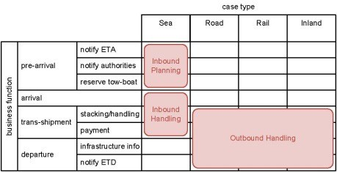
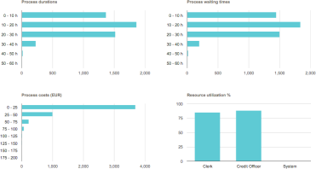

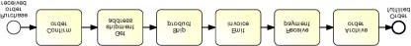


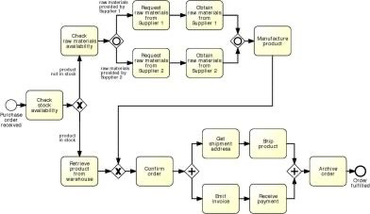
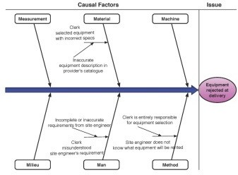


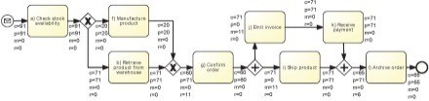
BPM Lifecycle
Process identification
Process architecture
Conformance and performance insights
Process discovery
As-is process model
Process monitoring and controlling
Process analysis
Executable process model
Insights on weaknesses and their impact
Process implementation
Process redesign
To-be process model
2

Slide 3
The business process model that we created so far is conceptual (abstract in nature) that does not provide any implementation details. So, conceptual process model needs to be converted into executable process model, which can automatically be interpreted and executed by a software system such as BPMS.
The conceptual process models are created by domain experts while the executable process models are created by IT Experts.
Five-step method to incrementally transform a conceptual process model into an executable one. The steps are:
1. Identify the automation boundaries,
2. Review manual tasks,
3. Complete the process model,
4. Bring the process model to an adequate level of granularity, and
5. Specify execution properties.
These steps should only be carried out on a process model that is syntactically correct. For example, if the model contains behavioral errors like deadlocks, then the BPMS may get stuck while executing an instance of this process model.

Slide 4
Identify the automation boundaries
Accordingly, the principle driving this first step is that not all processes can be automated.
Based on this principle, we start by identifying which parts of our process can be coordinated by the BPMS and which parts cannot.
To do so, we distinguish three types of tasks, in line with the BPMN language: automated, manual, and user tasks.
Automated tasks are performed by the BPMS itself or by an external service.
Manual tasks are performed by process participants without the aid of any software.
User tasks sit between automated and manual tasks. A user task is a task that is performed by a participant with the assistance of the worklist handler of the BPMS or an external task list manager
The differentiation between automated, manual, and user tasks is important:
Automated and user tasks can easily be coordinated by a BPMS, while manual tasks cannot.
In the next step, we review the manual tasks and assess whether we can find a way to hook them up
to the BPMS. If this is not possible, we will have to consider whether or not it is convenient to automate the rest of the process without these manual tasks.

Slide 5
Lets consider, order-to-cash process model.
Obtain model from the perspective of seller.
Automated Task
“Check stock availability”
“Check raw materials availability
“Manufacture product”
“Request raw materials from Supplier 1(2)” – can be implemented through sending and receiving mail
“Get shipping address” – can be implemented through sending and receiving mail
Manual
1. “Retrieve product from warehouse” - requires a warehouse worker to physically pick up the product from the shelf for shipping
2. “Obtain raw materials from Supplier 1(2)”
3. “Ship product” are manual
User Task
“Confirm order” is an example of a user task: it requires somebody in sales (e.g., an order clerk) to verify the purchase order and then confirm that the order is correct.

Slide 6
The distinction between automated, manual, and user tasks is captured in BPMN via specific markers on the top-left corner of the task box.
Manual tasks are marked with a hand, while user tasks are marked with a user icon.
Automated tasks are further classified into the following subtypes in BPMN:
• Script (script marker), if the task executes some code (the script) internally to the BPMS. This task can be used when the functionality is simple and does not require access to an external application, e.g., opening a file or selecting the best quote from a number of suppliers.
• Service (gears marker), if the task is executed by an external application, which exposes its functionality via a service interface, e.g., “Check stock availability” in our example.
• Business rule (table marker), if the task triggers a business rule to be executed by a rules engine external to the BPMS, e.g., the rule for approving a loan.
• Send (filled envelope marker), if the task sends a message to an external service, e.g., “Request raw materials from Supplier 1”.
• Receive (empty envelope marker), if the task waits for a message from an external service, e.g., “Get shipping address”.

Slide 7
Review Manual Task
Once we have identified the type of each task, in the second step of our method we need to check whether we can link the manual tasks with the BPMS.
The principle driving this step is: if the task cannot be seen by the BPMS, it does not exist.
So, we either find a way to support manual tasks via technology or, alternatively, we need to isolate these tasks and automate the rest of the process.
There are two ways of linking a manual task to a BPMS:
We implement it either via a user task or via an automated task.
Implement as User Task:
If the participant involved in the manual task can notify the BPMS of the task completion using the worklist handler of the BPMS, then the manual task can be turned into a user task. For example, the warehouse
worker performing task “Retrieve product from warehouse” could check out a work item from the worklist to indicate that the task is being worked on, manually retrieve the product from the shelf, and then check in the work item back into the BPMS engine.
Implement as Automated Task:
In some cases, a process participant may use technology that is integrated with the BPMS to notify the engine of a work item completion. For example, the warehouse worker could use a device such as a barcode scanner to scan the barcode of the raw materials that are picked up signifying that product has been obtained. “Obtain raw materials from Supplier”
The tasks required for assessing applications cannot be automated, because they involve various human participants who interact on an ad hoc basis. It would not be convenient to synchronize all these tasks with the BPMS. So, we need to isolate the task “Assess application”, an ad hoc task containing various manual tasks, and automate the process before and after this task. An option is to split the model into three fragments as shown in Figure 10.2 and only automate the first and the third fragment. Another option is to keep one model and simply remove the ad hoc task.

Slide 8
Complete the process
Once we have established the automation boundaries of the process and reviewed the manual tasks, we need to check that our process model is complete.
Two principles underlie this step:
exceptions are the rule and
(ii) no data implies no decisions and no task handoff.
In conceptual process model, certain information are neglected as they assume that it is common knowledge or they are simply not aware of it. Depending on the application scenario, it is okay to ignore this information in conceptual model. However, information that is not relevant in a conceptual model may be highly relevant for a process model to be executed.
Ex: in the order-to-cash process. For example, this process may be aborted if the materials required to manufacture the product are not available at the suppliers or if the customer cancels the order.
So, based on the first principle above, we need to make sure that all exceptions are handled using appropriate exception handlers. For example, if the order cancelation is received after the product has been shipped or after the payment has been received, then we also have to compensate for these tasks by returning
the product and reimbursing the customer. Another exception that is commonly
neglected is the situation when a task cannot complete correctly.What happens if the
customer’s address is never received? Or if the ERP module for checking the stock
availability does not respond? We cannot assume that the other party will always
respond or that a system will always be functional. Similarly, we cannot assume
that tasks always lead to a positive outcome. For example, an order may not always
be confirmed.

Slide 9
Based on second principle, each task in the process must have all input needed for the task to start and output generated by that task.
Ex: “Request raw materials from Supplier 1(2)” needs list of raw materials to be ordered as input.
“Check stock availability” requires purchase order as input to obtain the code of product to be looked up into the warehouse database. The output of this task is search result. If output is not modelled, the subsequent XOR-split cannot determine which branch to take.
So, make sure each task has the required input and output electronic data objects. The point is that every data object needed by the BPMS engine to pass control between tasks and to take decisions must be modeled.

Slide 10
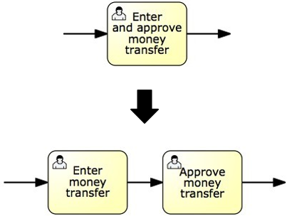
Bring process model to adequate granularity level
Tasks in a conceptual model may not be at the right level of granularity for implementation.
They may be either too abstract, in which case we need to decompose them, or too detailed, in which case they should be aggregated.
For example, two consecutive tasks assigned to the same resource are candidates for aggregation.
In a similar way, if a task requires more than one resource to be performed, then it is too coarse-grained. We should then decompose it into finer grained tasks such that these can be assigned to different resources.
The principle driving these examples is that a BPMS adds value if it coordinates handoffs of work between resources.
Decomposition -> In case of enter and approve money transfer, there can be one staff to enter details and other to approve the money transfer. So, this task in the process can be decomposed into two separate tasks.
Aggregation -> Tasks on a conceptual level can also be too fine-grained. For example, a sequence of user tasks “Enter customer name”, “Enter customer policy number”, and “Enter damage details” should be aggregated into a single user task “Enter claim” if they are all supposed to be performed by the same claims handler.

Slide 11
Specify Execution Properties
At the end of the fourth step, we obtain a to-be-executed process model, i.e., a process model that contains the right elements and is at the right level of granularity to be automated with a BPMS. However, this model is still technology-agnostic.
That is to say, it is independent of the specific BPMS technology we will choose for automation.
To make the model fully executable, we need to specify in the last step how each model element is effectively implemented by our BPMS of choice.
For example, take the first service task of our revised order-to-cash example: “Check stock availability”. Saying that this task requires the purchase order as input to contact the warehouse ERP system is not enough. We need to specify which specific service provided by the ERP system is to be used to check the stock levels, the location of its interface in the network, the format of its input object (the purchase order), and the format of its output object (the stock availability). These implementation details are called execution properties. They are required to obtain a fully-executable process model.

Slide 12





From “conceptual” to executable models
Conceptual “to-be” process models
are made by domain experts
provide a basis for communication amongst relevant stakeholders
must be understandable
must be intuitive and may leave room for interpretation
contain purely a relevant set of process information
Executable process models
are made by IT experts
provide input to a process enactment system - BPMS
must be machine readable
must be unambiguous and should not contain any uncertainties
contain further details that are only relevant to implementation
“to-be executed” process model
12

Slide 13
Bridging the gap: A five-step method
Identify the automation boundaries
Review manual tasks
Complete the process model
Adjust task granularity
Specify execution properties
Adapted from teaching material of Remco Dijkman, TU/e.
4

Slide 14
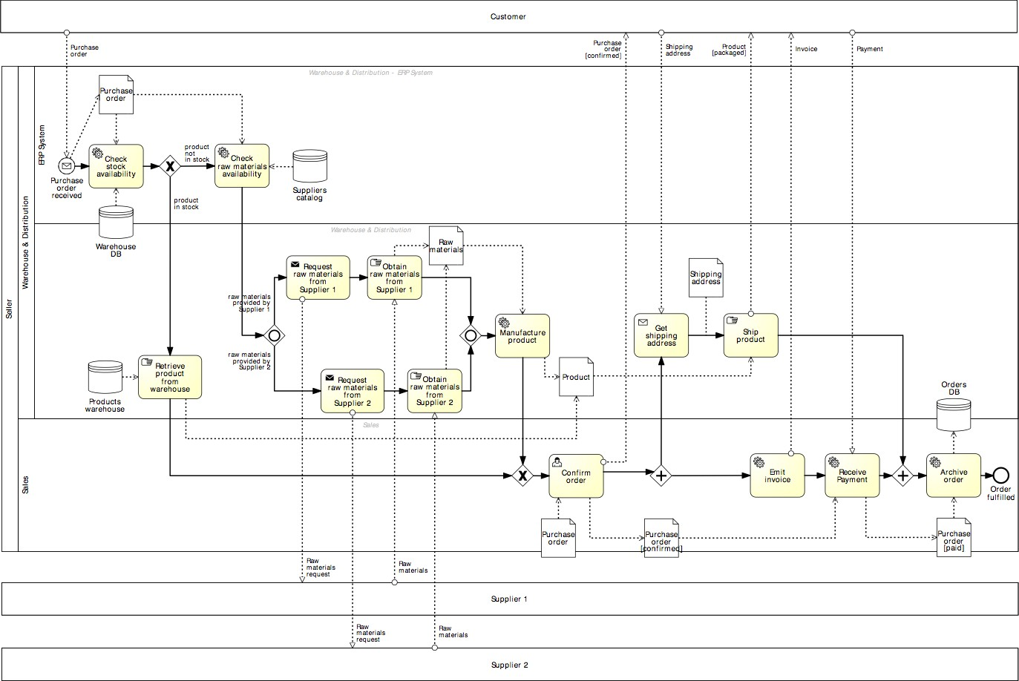
Running example
14

Slide 15
Running example
Customer
Seller
Supplier 1
Supplier 2
15

Slide 16
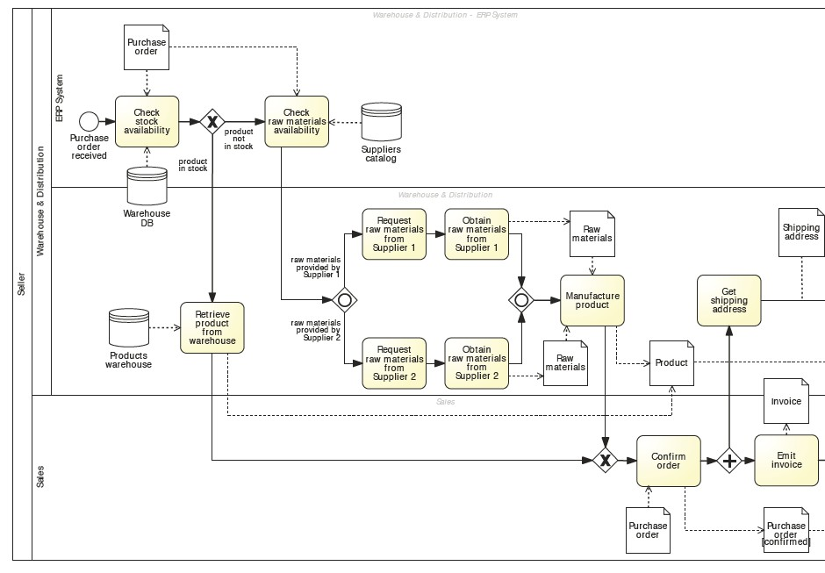
Running example

Slide 17






1. Identify the automation boundaries
Principle: not all parts of a process can be automated.
-> Start by identifying each task’s type:
1
2
3
Automated tasks
User tasks
Manual tasks
17

Slide 18
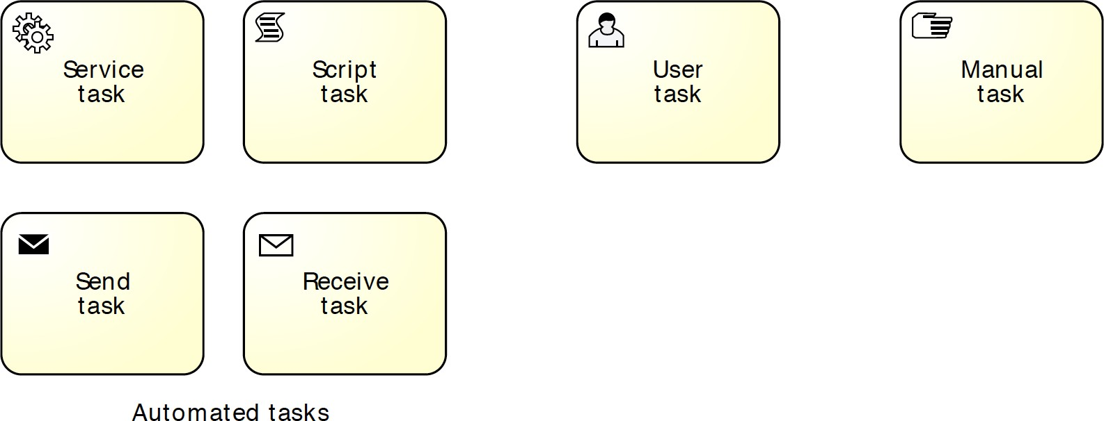
In BPMN: specify task markers
Automated tasks
User task
Manual task
18

Slide 19
automated user manual
In our example…

Slide 20




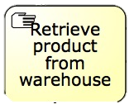
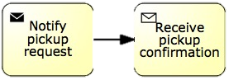
2. Review manual tasks
Principle: if it can’t be seen by the BPMS, it doesn’t exist.
-> Find ways to support manual tasks via IT:
via user task
via automated task

Slide 21

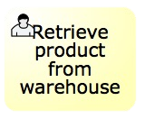
2. Review manual tasks
Principle: if it can’t be seen by the BPMS, it doesn’t exist.
-> Find ways to support manual tasks via IT:
via user task
via automated task
-> Leave them out of the automated process

Slide 22
3. Complete the process model
Principle: exceptions are the rule.
Consider incomplete paths
Rules of thumb
If we send something to another party, what happens if they do not respond? What happens if the response comes late? What happens if they do not respond the way we expect?
For each task: Can it go wrong and what happens if it goes wrong?
For each external party: Have we captured all messages or queries they might send us?
Principle: no data = no decisions, no tasks handover.
Specify all (electronic) business objects
For each task, determine which business objects it creates, reads, updates, delete (CRUD)
For each decision, determine which objects it needs

Slide 23
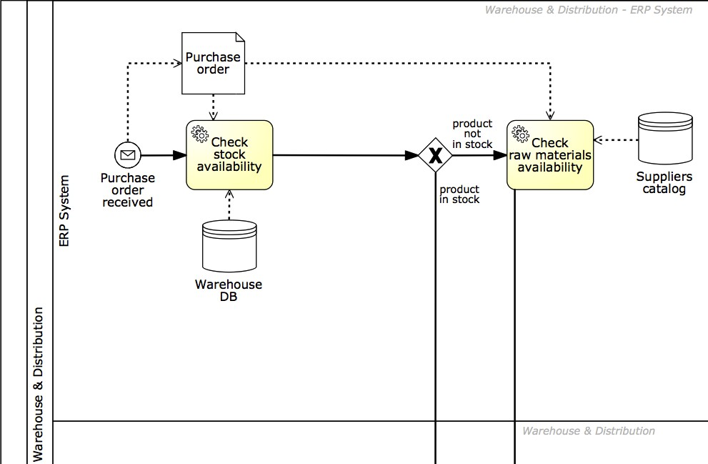
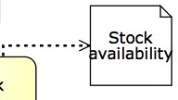
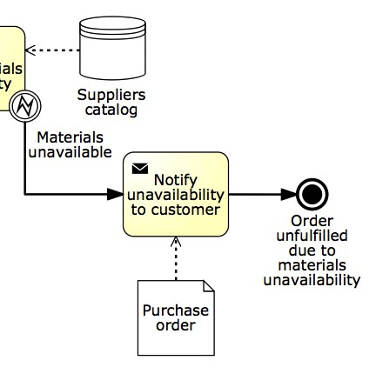
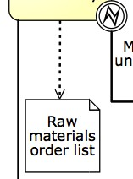
In our example…

Slide 24




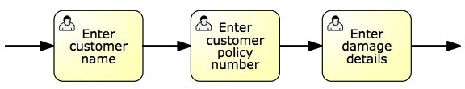
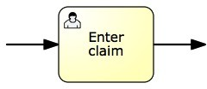
4. Adjust task granularity
The goal is to coordinate handovers of work between resources, therefore:
-> Aggregate consecutive tasks assigned to the same performer

Slide 25
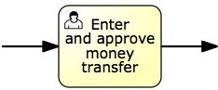
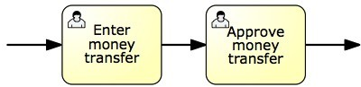
4. Adjust task granularity
The goal is to coordinate handovers of work between resources, therefore:
-> Aggregate consecutive tasks assigned to the same performer
-> Split tasks if they require different performers

Slide 26

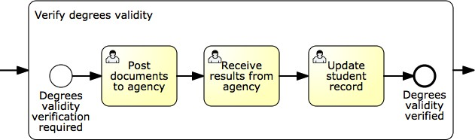
An exception to the rule

Slide 27
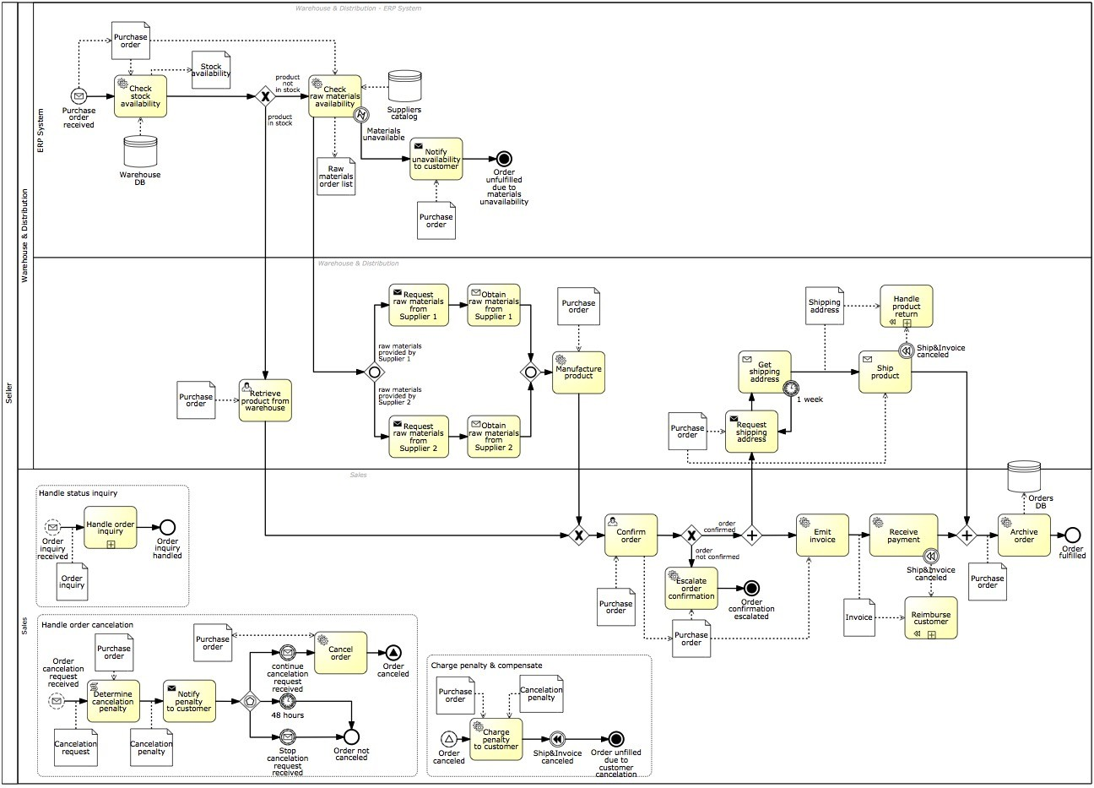
Our example…
After Step 4
Before Step 1

Slide 28
Bridging the gap: one task at a time
Identify the automation boundaries
Review manual tasks
Complete the process model
Adjust task granularity
5. Specify execution properties
19

Slide 29
5. Specify execution properties
→ Process variables, messages, signals, errors
→ Task and event variables and their mappings to process variables
→ Service details
→ Code snippets
→ Participant assignment rules
→ User interface specification (e.g. forms)
→ Task, event and sequence flow expressions
→ BPMS-specific: work queues, forms, connectors…

Slide 30
BPMS
A Business Process Management System (BPMS) is a system that supports the design, analysis, execution, and monitoring of business processes on the basis of explicit process models.

Slide 31
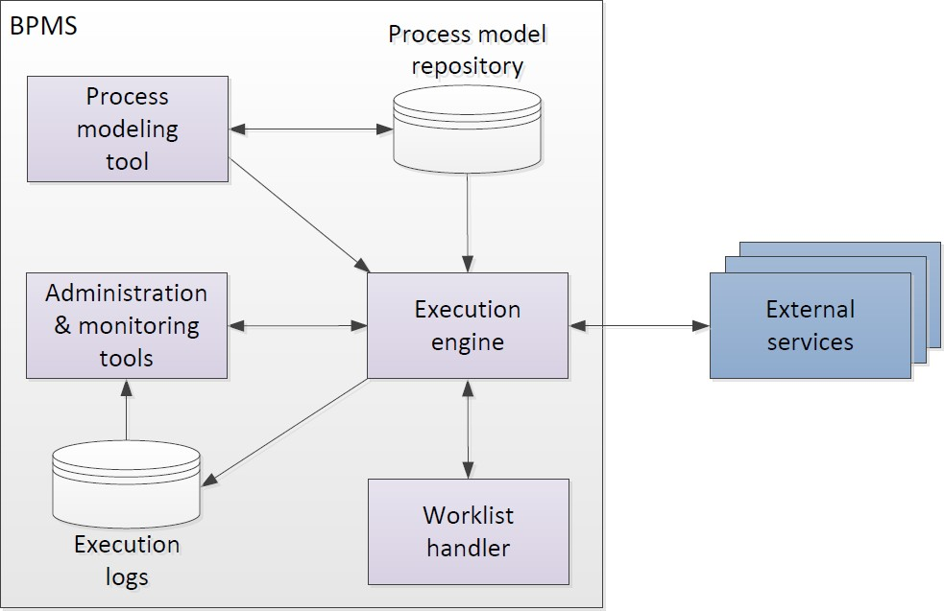
Business Process Management System

Slide 32
Process modeling tool
To create and modify executable process models (by specifying execution properties)
To store and retrieve automation solutions from a process model repository

Slide 33
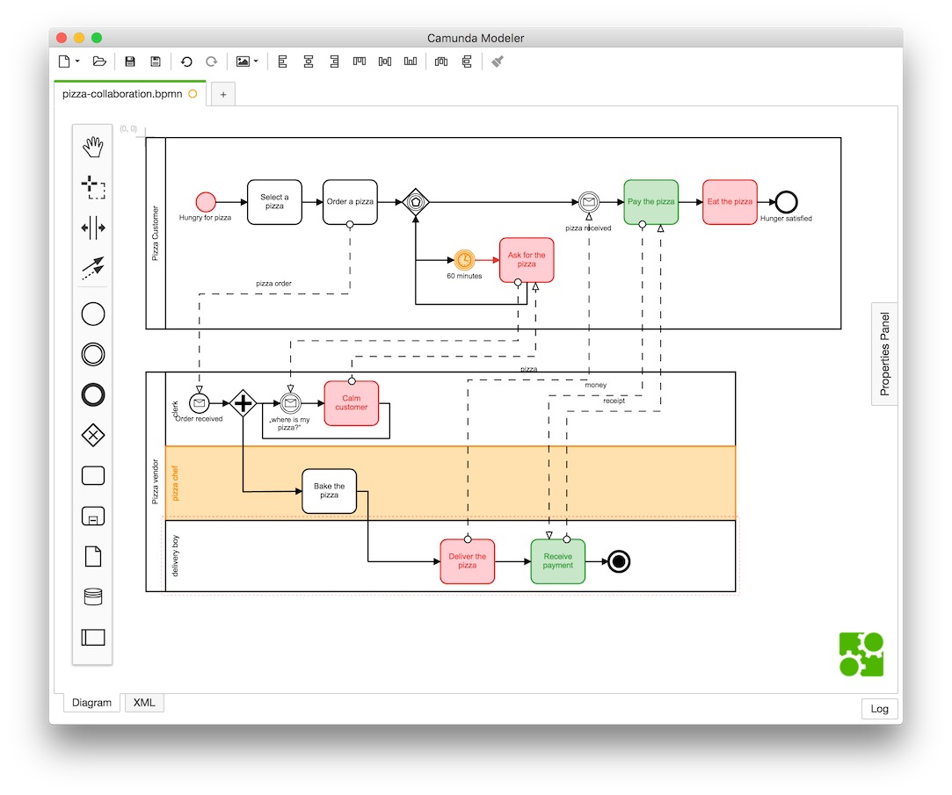
Example of a Process modeling tool
Camunda Modeler

Slide 34
Execution Engine
Instantiates executable process models (also called “cases”)
Orchestrates distribution of work items to process participants and software services in order to execute a business process from start to end
Logs execution data
34

Slide 35
Worklist Handler
Imagine it as an “inbox”
Offers work items to process participants and allows participants to commit to these work items
Handles participants’ work queues and work item priorities
May provide social network capabilities
35

Slide 36

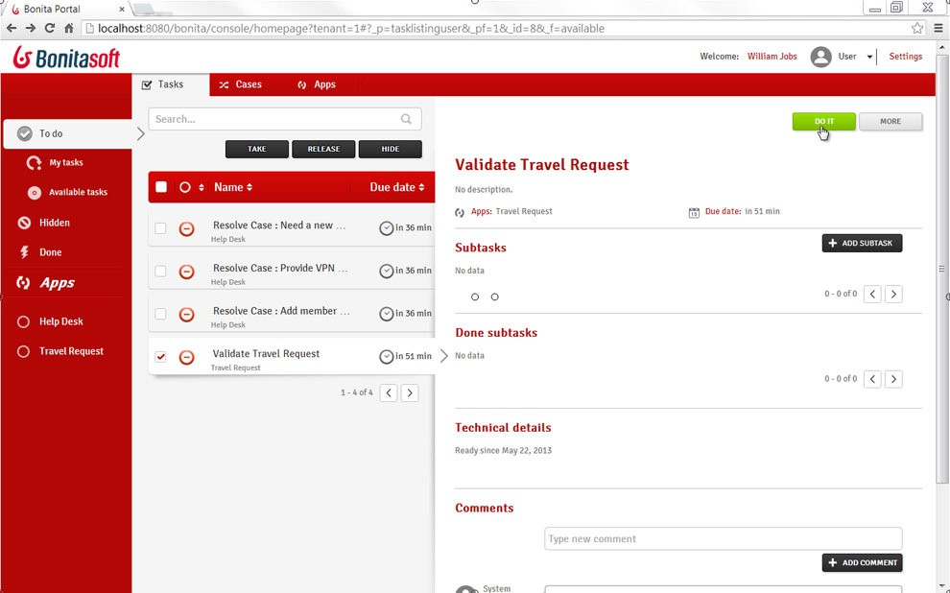
Example of a Worklist Handler
Bonita Soft Bonita Open Solution
36

Slide 37
Administration & Monitoring Tools
To manage automation solutions
To configure access to system components
To monitor participants availability and performance of process cases
37

Slide 38

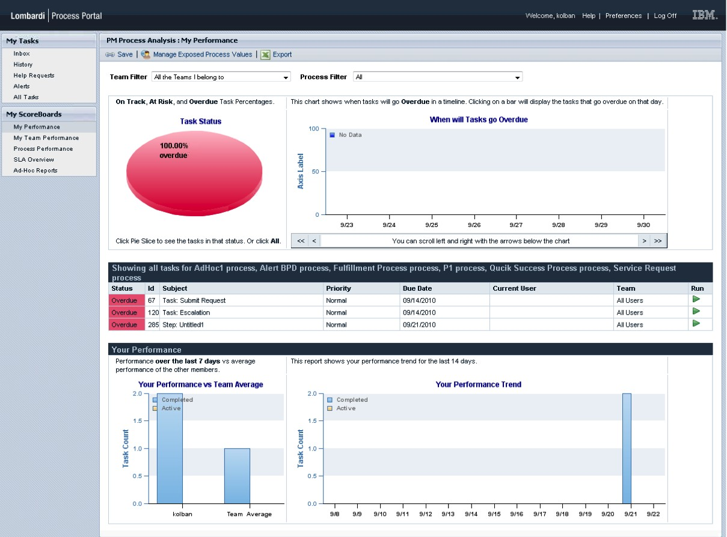
Example of an Administration & Monitoring Tool
IBM BPM Process Portal
38

Slide 39
External Services
Expose a service interface with which the engine can interact
The engine provides the invoked service with the necessary data it will need to perform the activity for a specific case
Examples: rules engine, email or Twitter notification, DB connector, CRM connector
External services: It may be useful to involve external applications in the execution of a business process.
In many business processes, there are activities which are performed fully automatically, such that the execution engine can simply call an external application, for example to assess the creditworthiness of a client.
The external application has to expose a service interface with which the engine can interact. We refer to such applications as external services.
39

Slide 40
BPMS Landscape
Closed source
Commercial open-source
BIC Platform
BizAgi
IBM BPM
OpenText BPM
Oracle BPMS
Pega Platform
Software AG webMethods
Bonita Platform
Camunda
Flowable
JBoss jBPM
ProcessMaker
40

Slide 41
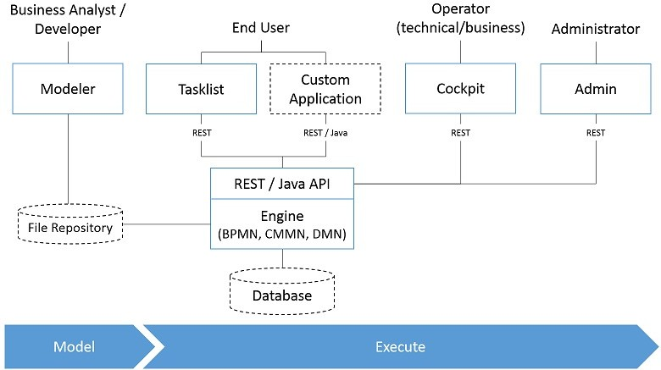

Camunda Architecture

Slide 42







Where are we?
Process identification
Process architecture
Conformance and performance insights
Process discovery
As-is process model
Process monitoring and controlling
Process analysis
Executable process model
Insights on weaknesses and their impact
Process implementation
Process redesign
To-be process model
32

Slide 43
Process Monitoring
Process monitoring is about using the data generated by the execution of a business process in order to extract insights about the actual performance of the process and to verify its conformance with respect to norms, policies, or regulations.
The data generated by business process executions generally takes the form of collections of event records. Each event record captures a state change in a process, such as the start or completion of a task, an incoming or outgoing message, or a timeout or escalation. Collections of such event records are called event logs.
Business process monitoring techniques take as input event logs and produce a number of artifacts to help process participants, analysts, process owners, and other managers to get a picture of the performance of the process at different levels of detail.
Some performance monitoring techniques allow us to detect that the actual execution of the process deviates with respect to the intended execution captured in a process model, e.g., an invoice is paid out before it is approved by a financial officer, whereas normally this should not be the case.
Other techniques help analysts to understand how and why the performance of a process varies across different cases or groups of cases, e.g., why some use cases take too long to be completed. Or why some cases lead to customer complaints.

Slide 44
Process Performance Dashboard
Visual representation of business performance measures to help business users answer one or more business questions.
Operational Dashboard
Operational process dashboards target process participants and their operational managers (including the process owner). Their purpose is to display the performance of ongoing or recently completed cases in a way that allows process participants and their managers to plan their short-term work.
Typical measures displayed in an operational dashboard include the number of ongoing cases (work-in-process) classified by type of cases. For example, a dashboard may display the number of cases that are on time, overdue, and at risk of being overdue.
Tactical Dashboard
Tactical process dashboards target at process owners / managers
The purpose of tactical dashboards is to give a picture of the performance of a process over a relatively long period of time (e.g., a month or quarter or even a year) in order to put get idea of how well was the process executed in the given interval of time.
Typical measures displayed in a tactical process dashboard include number of completed cases, cycle time, waiting times, processing times, resource utilization, cost per case, and defect rate. For a given performance measure, a tactical dashboard may display statistics such as the minimum, maximum, mean, and standard
deviation of this measure, or the entire distribution of the performance measure in the form of a histogram.
Strategic Dashboard
Aimed at executives & managers. Emphasis on linking process performance to strategic objectives. Their purpose is to provide a high-level picture of the performance of groups of processes along multiple performance
dimensions.

Slide 45


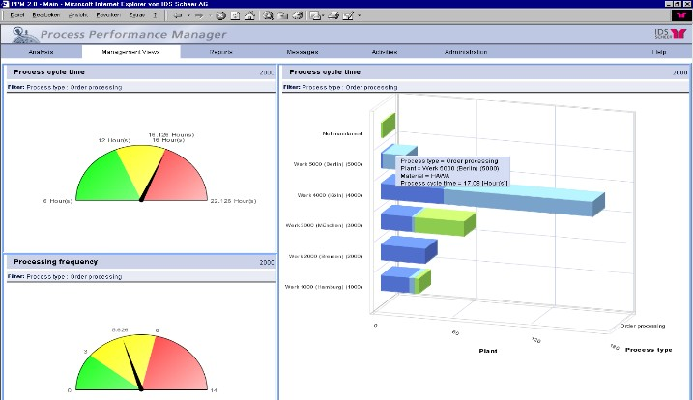

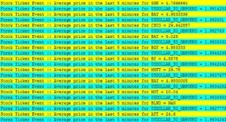



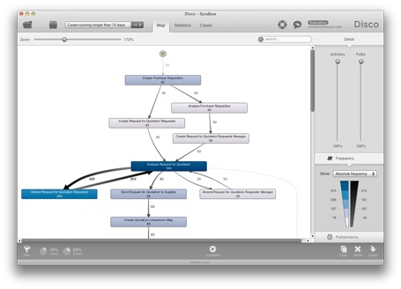
Business Process Monitoring
Performance Dashboards
Event stream
Enterprise System
Process Mining
Database
Event log

Slide 46
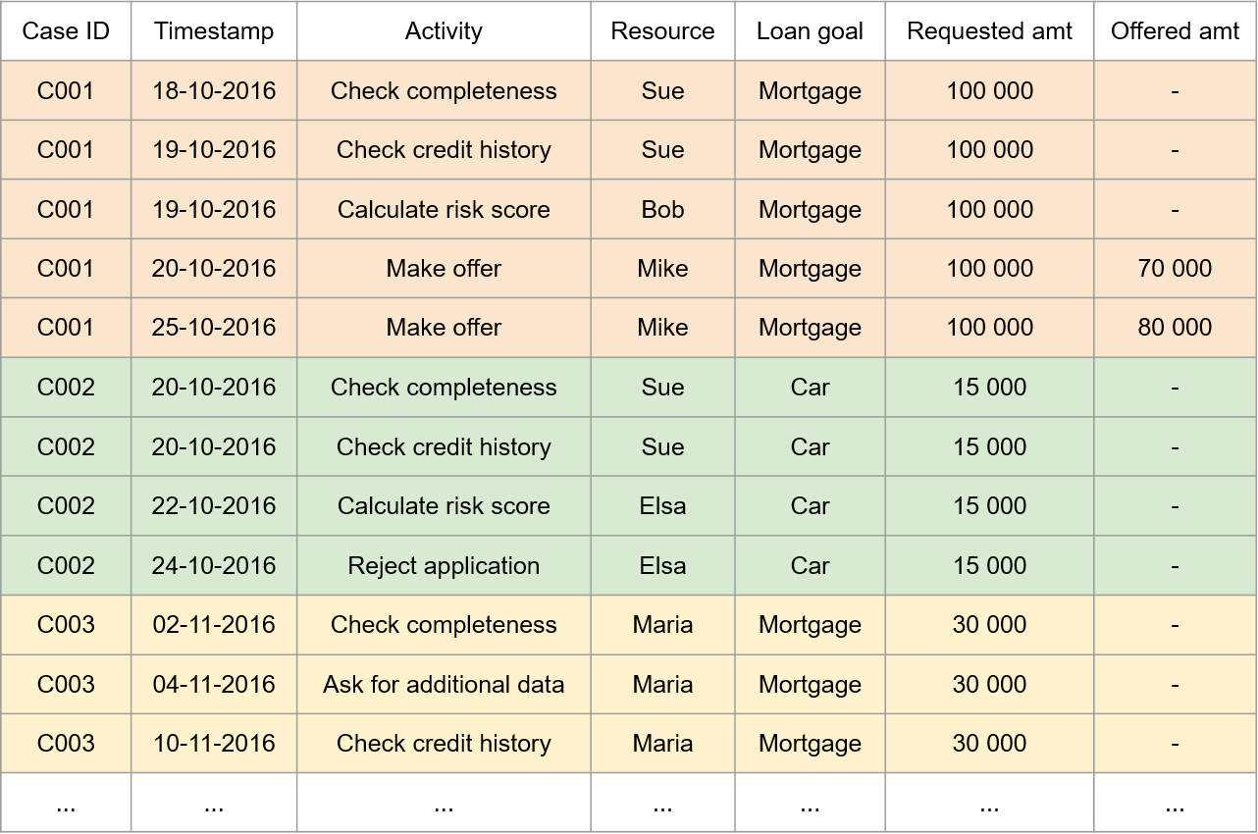
Structure of a Business Process Event Log

Slide 47






Process performance dashboard
A visualization of a collection of process performance measures to put into evidence information and patterns to help business users answer one or more business questions
Process Dashboards
Operational dashboards (runtime)
Tactical dashboards (historical)
Strategic dashboards (historical)
35

Slide 48

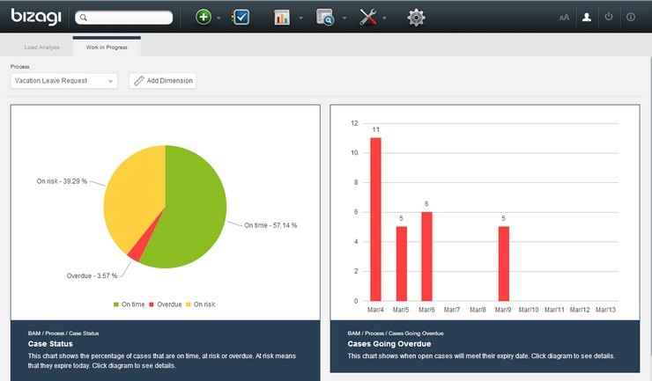
Operational process dashboards
Aimed at process workers & operational managers
Emphasis on monitoring (detect-and-respond), e.g.:
Work-in-progress
Problematic cases – e.g., overdue/at-risk cases
Resource load

Slide 49

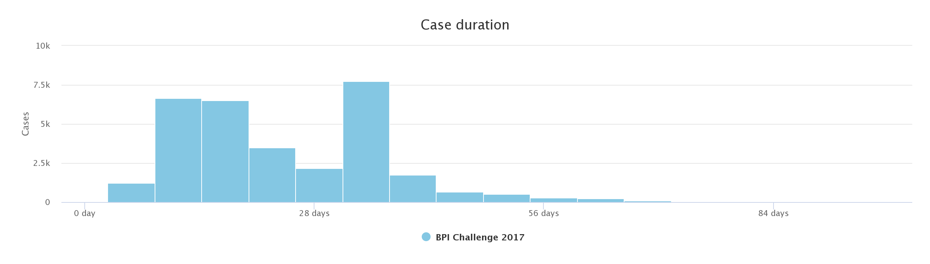
Tactical performance dashboards
Aimed at process owners / managers
Emphasis on analysis and management
E.g., detecting bottlenecks
Typical process performance indicators
Cycle times
Error rates
Resource utilization

Slide 50
Strategic performance dashboards
Process: Manage Procurement
0.67
Aimed at executives & managers
Emphasis on linking process performance to strategic objectives
Pr
ocess: Manage Emergencies & Disasters
0.58
Pro
ces
s: Manage Unplanned Outages
Overall Process Performance
0.54
1st L Key Area
ayer Resu
lt
Financial
People
Customer
Operational
Risk Management
Health & Safety
0.4
Excellence
Excellence
0.5
0.65
0.5
0.8
0.4
2nd Layer
Key Performance
Customer
Customer
Complaint
Satisfaction
0.6
0.7
Customer
Customer
Average Time
3rd & 4th Layer Process Performance
Rating (%)
Loyalty Index
Spent on Plan
0.7
0.6
0.8
Measures
Satisfied
Market
Customer Index
Share (%)
0.4
0.8

Slide 51



Process performance dashboards
A dashboard is a collection of widgets
Each widget displays at least one performance measure
E.g. The average case duration
Four types of widgets:
Single-dimensional widgets Two-dimensional widgets Three-dimensional widgets
N-dimensional widgets (tables)
39

Slide 52
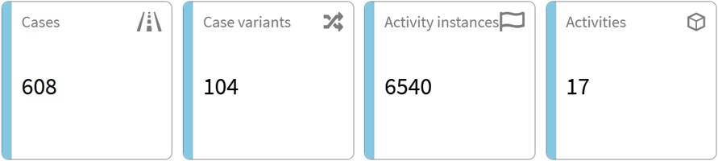
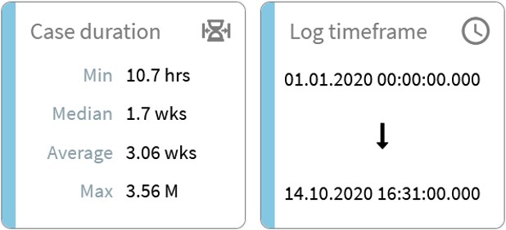
Process performance dashboard widgets
Single-dimensional widgets display one variable
We can group multiple measures in one widget for convenience.
40

Slide 53
Process performance dashboard widgets
Two-dimensional widgets display two variables:
Independent variable (x-axis) – variable with respect to which we want to analyze
Dependent variable (y-axis) – the variable that we wish to analyze
Usually, a two-dimensional widget is a chart
Bar chart, pie chart, etc.
Types of two-dimensional charts:
Longitudinal charts: x-axis is time, y-axis is a performance measure
Cross-sectional chart: x-axis is an attribute (e.g. activity, resource, country), y-axis is a performance measure
Histogram: x-axis is a performance measure, y-axis is a “count”
41

Slide 54
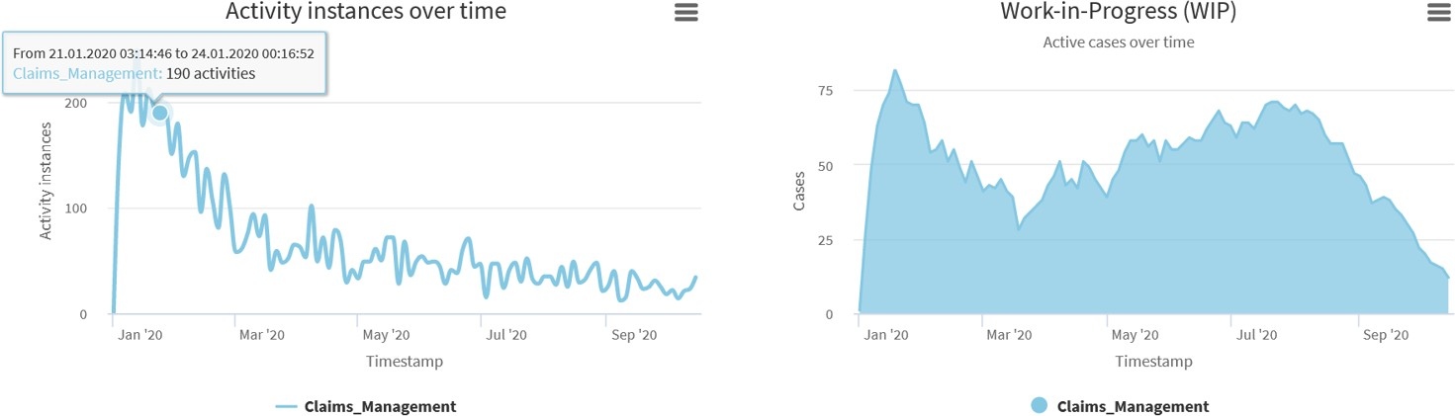
Process performance dashboard widgets
Longitudinal chart
10/27/23
54

Slide 55
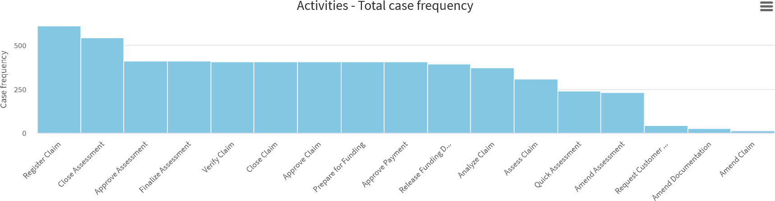
Process performance dashboard widgets
Cross-sectional chart
10/27/23
55

Slide 56
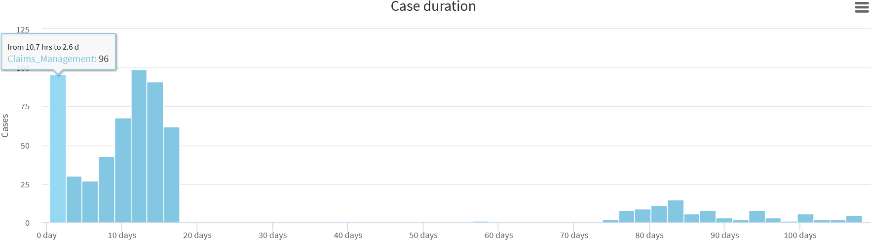
Process performance dashboard widgets
Cross-sectional chart
10/27/23
56

Slide 57
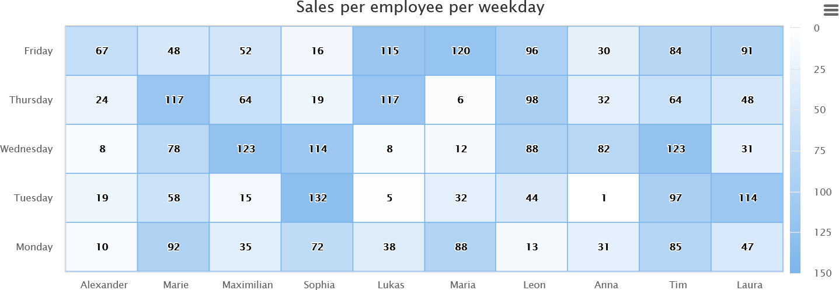
Process performance dashboard widgets
Three-dimensional widgets display three variables, usually:
Two cross-sectional variables
A performance measure
The third dimension can be coded in different ways:
Heat map: intensity and/or color
Bubble chart: size and/or intensity
Scatter plot: useful when the third dimension is Boolean
57

Slide 58
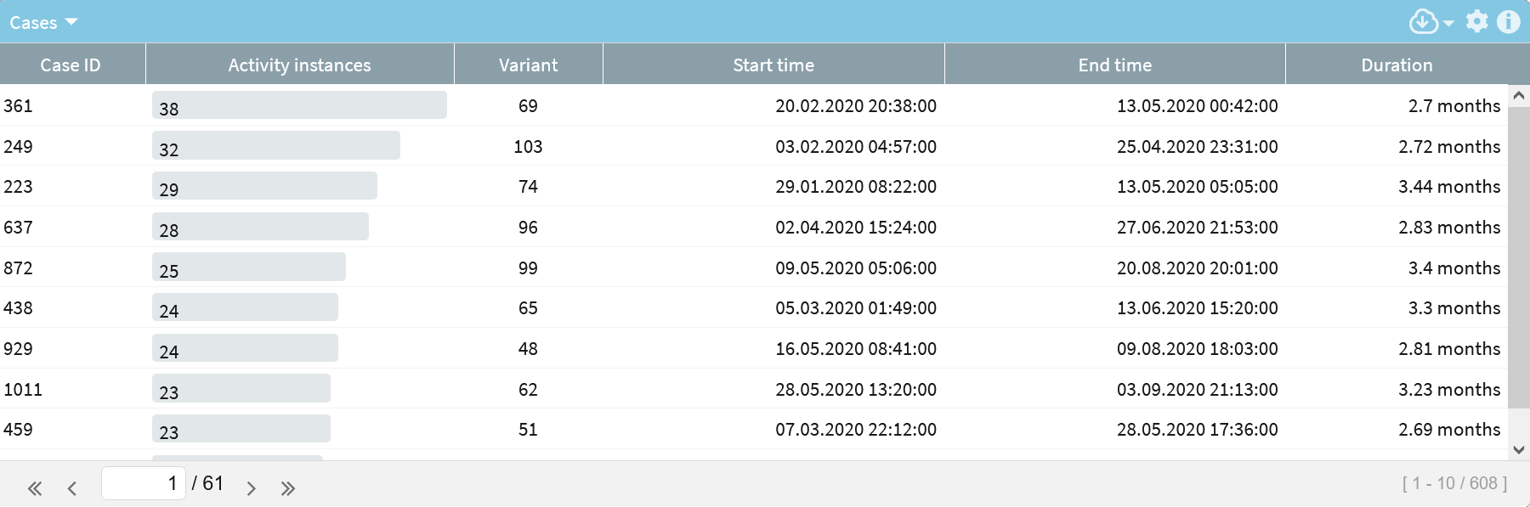
Process performance dashboard widgets
N-dimensional widgets display N dimensions, usually:
A cross-sectional variable
(e.g. the customer, the case identifier, etc.)
Several performance measures
In general, N-dimensional widgets are tables
58

Slide 59





Designing Process Performance Dashboard
Identify a user or users and define a clear question or set of questions that users will answer with this question
Identify the type of dashboard elements based on the insights required to answer the question
Identify a type of visualization (e.g. type of chart) for the element
Determine x-axis (independent variable): longitudinal time), cross-sectional (attribute)
Determine y-axis (dependent variable): performance measure or attribute and the aggregation function
47

Slide 60
Tools for performance dashboarding
Operational-Tactical – Business Activity Monitoring (BAM)
Axway AMPLIFY
VITRIA Operational Process Intelligence
Oracle BAM
SAP Operational Process Intelligence (OPI)
Tactical
Business Intelligence (BI) tools: PowerBI, Qlikview, Tableau…
Process Mining (dashboard modules): Apromore, Celonis, QPR, …
Strategic Level – Balanced Scorecard tools
BSC Designer Online, Quickscore, Sisense, etc.
48

Slide 61
Business Process Monitoring
Performance Dashboards
Event stream
Enterprise System
Process Mining
Database
Event log

Slide 62
Process Mining
Automated Process Discovery
discovered process model
event log
50

Slide 63
Process mining is a family of techniques to analyze the performance and conformance of business processes based on event logs produced during their execution.
Process mining techniques complement tactical process monitoring dashboards.
Specifically, these techniques allow us to understand how the process is actually being executed and to decorticate the performance of a process down to the level of individual tasks, resources, and handoffs.
process mining techniques can be classified according
to four use cases: (i) automated process discovery, (ii) conformance checking, (iii)
performance mining, and (iv) variants analysis.
Automated process discovery techniques take as input an event log and produce a business process model that closely matches the behavior observed in the event log or implied by the traces in the event log
Conformance checking techniques take as input an event log and a process model, and they give us as output a list of differences between the process model and the event log.
For example, the process model might tell us that after executing a task called A, we must execute a task called B. But maybe in the event log, sometimes after task A, we do not see task B. This might be because of an error, or more often than not, it is because of an exception that is not captured in the process model.
Some conformance checking techniques take as input an event log and a set of business rules instead of a process model. These techniques check if the event log fulfills the business rules, and if not, they show the violations of these rules.

Slide 64
Performance mining techniques take as input a process model and an event log and produce as output an enhanced process model. The enhanced process model contains additional elements (e.g., color-coded elements) that can answer questions like: “Why is the process slow?”, or “Where do we waste the largest amount of time in a business process?” In other words, they can pinpoint the bottlenecks that slow
down the process.
Finally, variants analysis techniques take as input two event logs (corresponding to two variants of a process) and produce as output a list of differences. Typically, one of the event logs contains all the cases that end up in a positive outcome according to some criterion, while the other log contains all the cases that end up in a negative outcome. For example, the first log may contain all cases where the customer was satisfied, while the second one contains all cases that led to a complaint. Or the first log may contain all cases where the process completed on time, while the second one contains the delayed cases. Variants analysis techniques
help their users to diagnose the reasons why an execution of a business process sometimes does not end up in a desirable outcome.

Slide 65
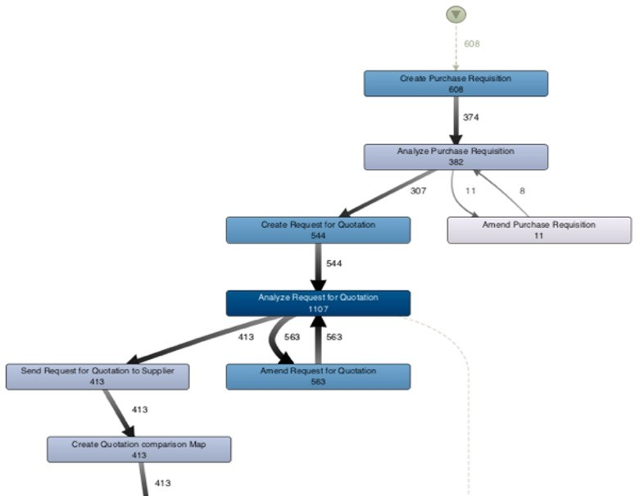












Automated Process Discovery
Process Map (directly follows graph)
CID | Task | Time Stamp | …
13219 | Enter Loan Application | 2007-11-09 T 11:20:10 | -
13219 | Retrieve Applicant Data | 2007-11-09 T 11:22:15 | -
13220 | Enter Loan Application | 2007-11-09 T 11:22:40 | -
13219 | Compute Installments | 2007-11-09 T 11:22:45 | -
13219 | Notify Eligibility | 2007-11-09 T 11:23:00 | -
13219 | Approve Simple Application | 2007-11-09 T 11:24:30 | -
13220 | Compute Installements | 2007-11-09 T 11:24:35 | -
… | … | … | …
BPMN process model
Retrieve Applicant Data
Enter Loan
Application
Notify Rejection
Compute
Installments
Approve Simple Application
Notify
Eligibility
Approve Complex Application
51

Slide 66
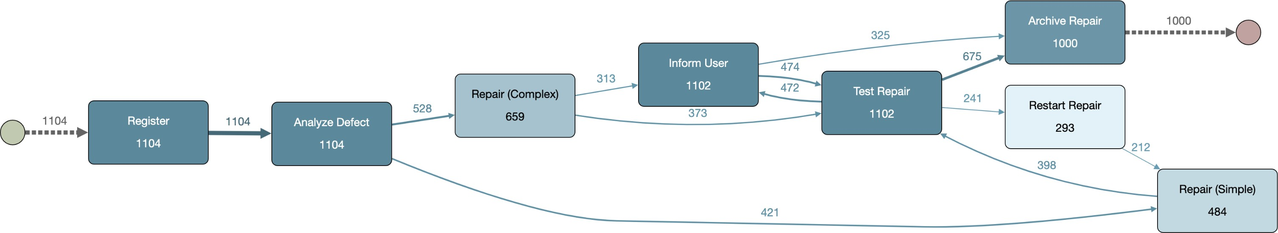
Process maps (aka Directly-follows graphs)
A process map of an event log is a graph where:
Each activity is represented by one node
An arc from activity A to activity B means that B is directly followed by A in at least one case in the log

Slide 67
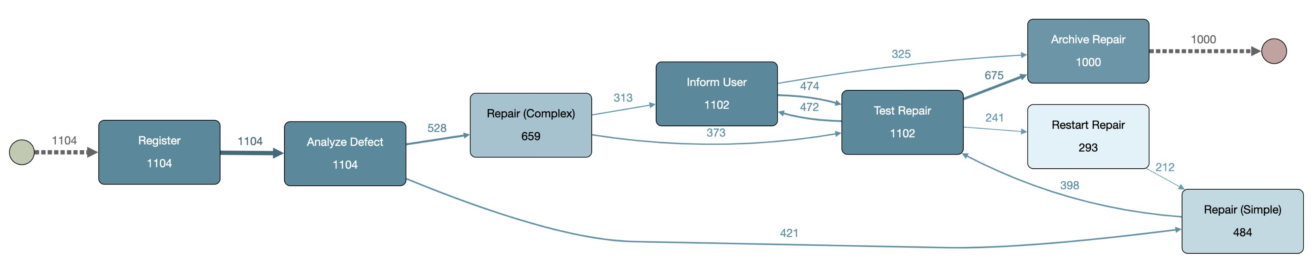

Anatomy of a Process map
Activity self-loop (rework)
Eventually-follows relation between two activities (not visualized)
Final activity (multiple possible)
Initial activity (multiple possible)
Activity
(and its frequency)
Short loop (possible rework)
Directly-follows relation between two activities (and its frequency)

Slide 68
Process maps: overlays
Nodes in a process map can be coloured, and arcs’ thickness can be changed, to capture:
Frequency: How often a given activity or directly-follows relation occurs?
Duration: processing times and cycle times for activities, waiting times for directly-follow relations
Other attributes: some tools support enhancement by other attributes, e.g., cost, revenue, sales volume, if these data attributes are available

Slide 69
Example: Process Map
with frequency
Event log
5: a,b,c,g,e,h
4: a,b,c,f,g,h
3: a,b,d,g,e,h
3: a,b,d,e,g,h
a
5
b
5
c
5
g
5
e
5
h

Slide 70
Example: Process Map
with frequency
Event log
5: a,b,c,g,e,h
4: a,b,c,f,g,h
3: a,b,d,g,e,h
3: a,b,d,e,g,h
a
5 + 4
b
5 + 4
4
c
5
4
f
g
5
4 e
5
h

Slide 71
Example: Process Map
with frequency
Event log
5: a,b,c,g,e,h
4: a,b,c,f,g,h
3: a,b,d,g,e,h
3: a,b,d,e,g,h
a
5 + 4 + 3
b
5 + 4
3
4
c
d
3
5
4
f
g
5 + 3
4 e
5 + 3
h

Slide 72
Example: Process Map
with frequency
Event log
5: a,b,c,g,e,h
4: a,b,c,f,g,h
3: a,b,d,g,e,h
3: a,b,d,e,g,h
a
5 + 4 + 3 + 3
b
5 + 4
3 + 3
d
4
c
3
5
4
f
g
3
3
4+ 3 e
5 + 3
5 + 3
h

Slide 73
Example: Process Map
with frequency
Event log
5: a,b,c,g,e,h
4: a,b,c,f,g,h
3: a,b,d,g,e,h
3: a,b,d,e,g,h
a
15
b
9
6
4
c
d
3
5
4
f
g
3
3
8
7 e
8
h

Slide 74
Process Maps
Commercial process mining tools use process maps as the main visualization technique for event logs
These tools also provide three types of operations:
Abstract the process map:
Filter the traces in the event log…
60

Slide 75
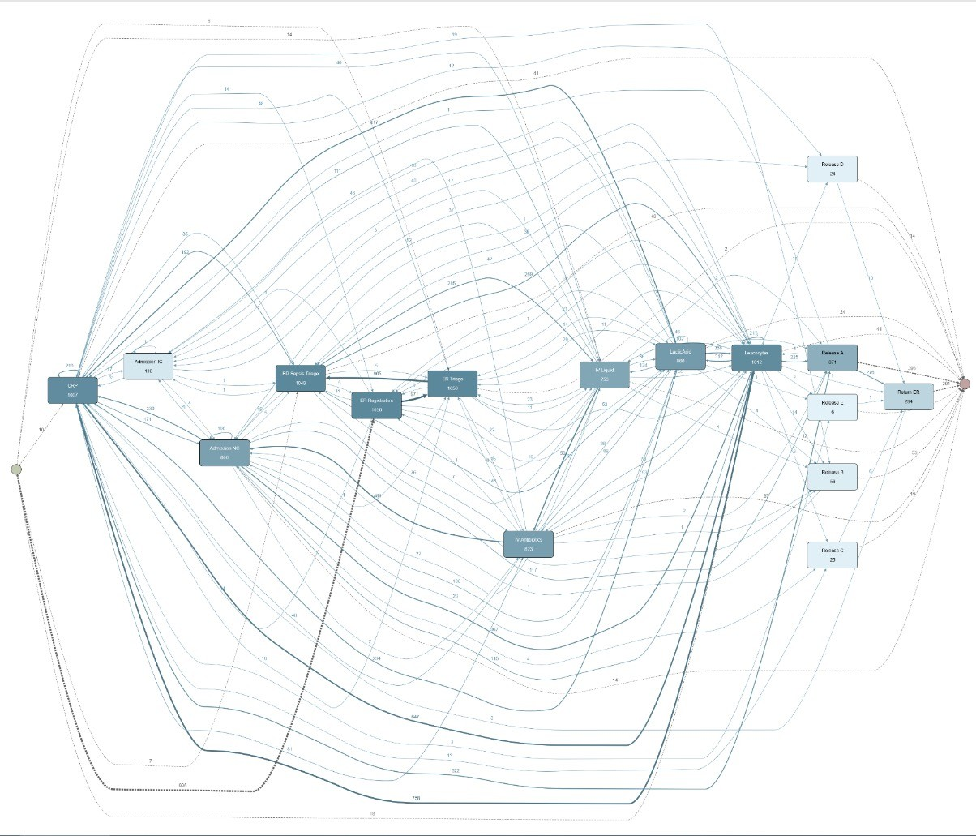
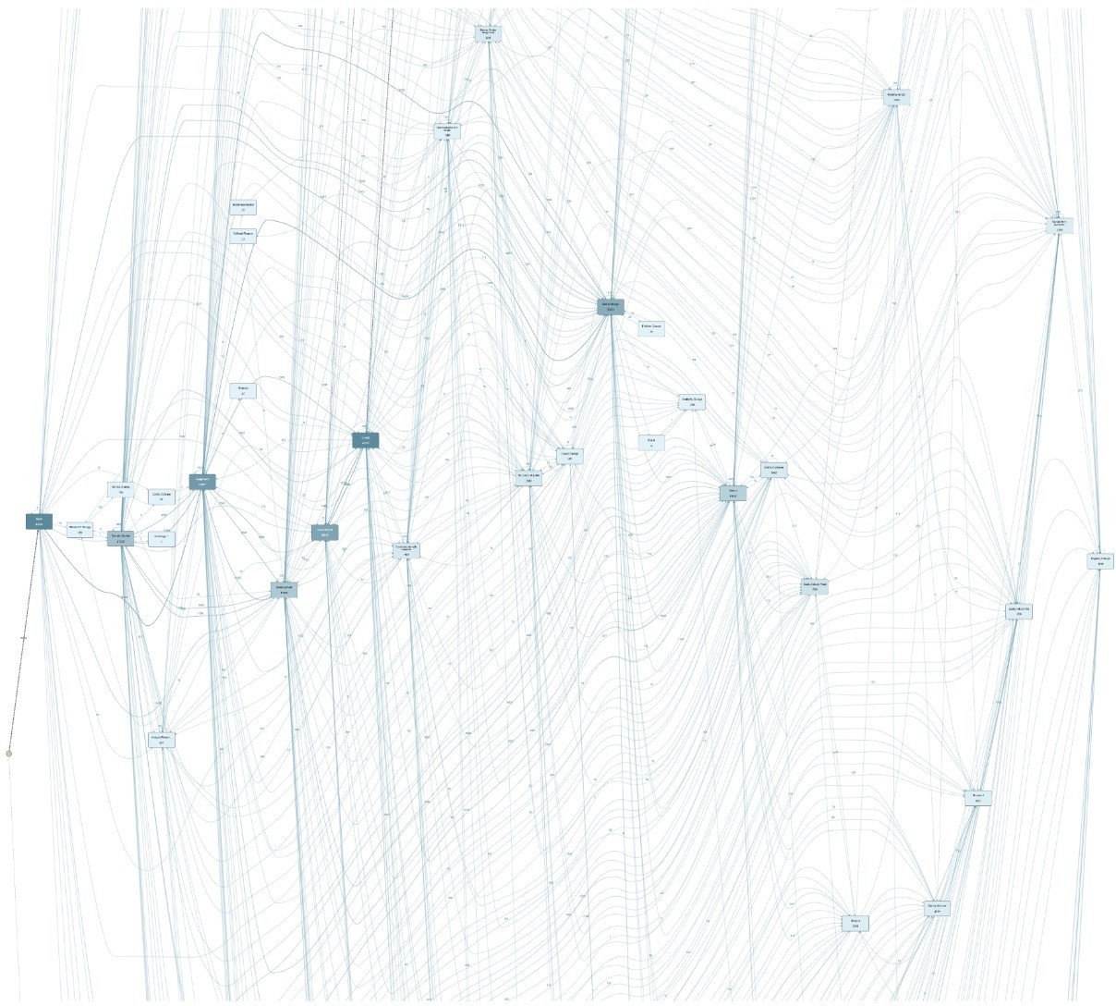
Abstraction and Filtering
Real-life processes are really messy
Patient Treatment Process @ Hospital (Sepsis infections)
IT Incident Management @ Bank

Slide 76
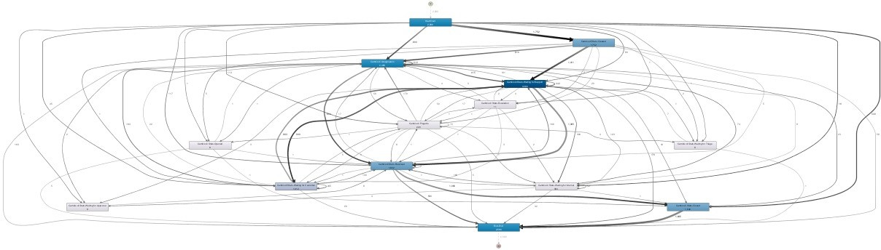
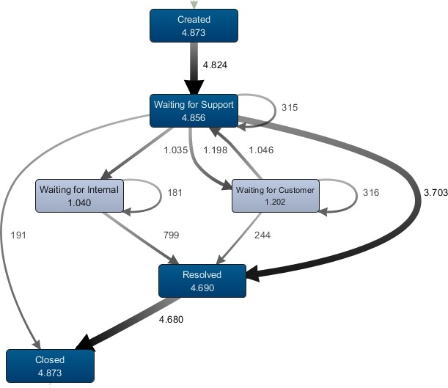

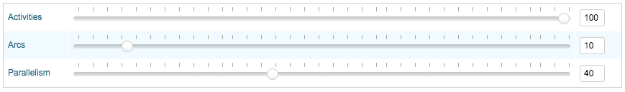
Process map: Abstraction
Common process mining tools provide abstraction capabilities on top of process maps, to:
Show only most frequent activities
Show only most frequent arcs
Some tools offer further abstraction capabilities to:
Show only least frequent activities
Show only least frequent arcs
Show only fastest/slowest activities
Show only fastest/slowest arcs

Slide 77
Log filters
Case-Level Log Filters
Retain (or remove) all cases that fulfill a given condition, for example all cases that take more than 3 days
Event-Level Filter
Retain or remove individual events (activity instances) that fulfill a given condition, e.g., all activity instances that were performed by “John Smith”
A case-level filter either retains an entire case or it removes the whole case while an event-level filter may remove some events in a case and remove others.
77

Slide 78
Case-Level log filters
Attribute filters
Retain only cases such that at least one event fulfils a condition over one or more attributes, for example: at least one event where Activity = “Close order” and Resource = “Anti Alman”
Timeframe filter
Retain traces that start, end, or are contained in a time period (e.g. all cases that started in January)
Performance filter
Retain only cases that have a duration above or below a given value (e.g. 3 days)
Path filter
Retain traces where there is a pair of events that fulfil a given condition (e.g. “Create invoice” eventually followed by “Create purchase order”)
Repetition filter
Retain traces that start with or finish with an event that fulfils a given condition
78

Slide 79
Event-Level log filters
Attribute filters
Retain only events that fulfil a condition, for example: at least one event where Activity = “Close order”
Timeframe filter
Retain all events that happen during a certain time period (e.g. all events in January)
Between filter
For each case, retain all events between the (first or last) occurrence of an activity and the (first or last occurrence) of another activity (e.g. between “Create PO” and “Approve PO”)
79

Slide 80
Automated Process Discovery
Process Map (directly follows graph)
CID | Task | Time Stamp | …
13219 | Enter Loan Application | 2007-11-09 T 11:20:10 | -
13219 | Retrieve Applicant Data | 2007-11-09 T 11:22:15 | -
13220 | Enter Loan Application | 2007-11-09 T 11:22:40 | -
13219 | Compute Installments | 2007-11-09 T 11:22:45 | -
13219 | Notify Eligibility | 2007-11-09 T 11:23:00 | -
13219 | Approve Simple Application | 2007-11-09 T 11:24:30 | -
13220 | Compute Installements | 2007-11-09 T 11:24:35 | -
… | … | … | …
BPMN process model
Retrieve Applicant Data
Enter Loan
Application
Notify Rejection
Compute
Installments
Approve Simple Application
Notify
Eligibility
Approve Complex Application
66

Slide 81
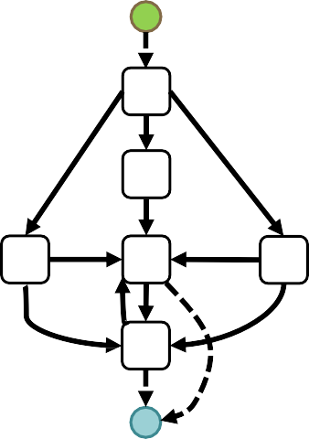
Limitations of process maps
Process maps over-generalize: some paths of a process map might actually not exist and might not make sense
Example: Draw the process map of [ abc, adc, afce, afec ] and check which cases it can recognize for which there is no support in the event log.
Process maps make it difficult to distinguish conditional branching, parallelism and loops
See previous example… or a simpler one: [ abcd, acbd ]
Solution: automated discovery of BPMN models
a
b
c e
a
+
f
d
a
b
c
+
d
b
c
d

Slide 82





Discovery of BPMN models
D
A given configuration of node/arc sliders, and parallelism slider
Note: Apromore uses an algorithm called Split Miner to turn process maps into process models

Slide 83
Process Mining
Automated Process Discovery
discovered process model
event log
Conformance Checking
/✗
process model or compliance rules
69

Slide 84

Conformance Checking (model-based)
Event log:
ABCDEH ACBDEH ABCDFH ACBDFH ABDEH ABDFH
Unfitting behaviour:
Task C is optional (i.e. may be skipped) in the log Additional behavior:
The cycle including IGDF is not observed in the log
70

Slide 85
Conformance checking (rule-based)
Oftentimes, we don’t have a full process model available
Instead, we have a set of compliance rules, e.g.
Certain tasks MUST be executed in every case
Certain tasks can be executed at most once
When a task A occurs, another task B must also occur (within e.g. 2 hours)
Two tasks A and B CANNOT be executed by the same person (four-eyes principle)
71

Slide 86
Conformance Checking Levels
Accordingly, we can identify the following compliance checking levels:
Flow: have all mandatory activities been performed? Have activities been performed in the right order and with the right frequency?
Temporal: has a given timeframe between activities, process milestones or for the end-to-end process been adhered to?
Resource: did everyone obey the segregation of duties?
Exception: explore highly-infrequent behavior to identify possible deviations from the standard process
Procedure:
Define compliance rules (based on attribute-value pairs, activity orders or performance targets)
Apply one or more filters to keep cases that violate the rules in question
If needed, switch perspective to highlight non-compliance issues (e.g. show resources that violate a segregation of duties principle)
Assess impact on process performance

Slide 87



Flow Compliance Checking
1
Mandatory tasks: Have all mandatory tasks been completed?
To check whether all your tasks have been executed at least once, change the frequency view to “Min.” in the visualization settings of your Process Discoverer.
5
The numbers in your activities now indicate the minimum number of times it has been completed in all process instances.
2
4
3
1

Slide 88







Temporal Compliance Checking
2
Prescribed time frame: Has the given time frame been adhered to?
Select the “Path” filter and define the steps that must be performed in a defined time frame. Use “Time interval” to then set your temporal figures.
^{Example:} Compliance rule:
Waiting time between “Inform User” and “Repair (Simple)” should not exceed 1 hours.
“Time Interval“ Filter:
> 1 hour, so that only those cases are retained that do not comply with the compliance rule.

Slide 89


Temporal Compliance Checking
1
Prescribed time frame: Has the given time frame been adhered to?
Performance filter can help to check for end-to-end SLA violations.
For example, retain only those cases that gets completed in at most 1 hour.

Slide 90





Resource Compliance Checking
1
Segregation of duties: Did everyone obey the segregation of duties?
To check whether the segregation of duties has been breached, select a “Path” filter. Now, set another filter which indicates that the same resource must have completed the tasks (e.g. creating & approving an invoice)

Slide 91


Resource Compliance Checking
1
Unexpected resource assignments
User the Attribute filter with two attributes (primary and secondary) to retrieve cases where a given activity was performed by a given resource (or any other combination of attributes)

Slide 92
Conformance Checking: Analysis Template
What?
Flow compliance checking Check skipped mandatory activities Check forbidden repetitions. Check activity exclusion or co- occurrence relations | Identify skipped activities in the process map or BPMN model Visualize process map with the min/max frequency metrics Visualize min/max statistics in Activity tab of the dashboard (EE) Use Path filter (directly-follows or eventually-follows)
Temporal compliance checking Check temporal constraints violations | Use performance filter (to check for end-to-end SLA violations) Use Path filter (eventually-follows) with a duration constraint to identify violations of temporal constraints between two activities
Resource compliance checking Check four-eyes principle or same-case- hander principle Check if an activity has been performed by a resource who should not do so. | Use Path filter (eventually-follows) and require the same Resource (or different resources) Use the Attribute filter and search with “Activity” as the primary attribute and “Resource” as secondary attribute to check if a resource performed an activity they were not supposed to do.

Slide 93

Process Mining
Automated Process Discovery
discovered process model
Performance Mining
event log
Enhanced process model
Conformance Checking
/✗
input process model
79

Slide 94
Process performance mining: Analytics & Analysis types
Extract process execution performance in an aggregate or detailed level (i.e. at the level of individual activities and directly-follows relations)
Analytics:
Duration-enhanced process maps (activity, resource perspective…)
Duration-enhanced BPMN models
Process performance dashboards
Analysis types:
Bottleneck analysis
Workload analysis
Rework analysis

Slide 95

Bottleneck analysis in the Activity perspective
Slow handoff between activities (transition is slow) [waiting bottleneck]
Resource-capacity bottleneck
(all incoming
arcs are slow) [waiting bottleneck]
Activity bottleneck (activity is slow)

Slide 96

Bottleneck analysis in the Resource perspective
Resource bottleneck
Slow handoff between
specific resources
[waiting bottleneck]

Slide 97

Workload analysis: overused vs underused resources
Potentially overused resources are those with high total frequency and/or high total duration
Potentially underused resources are those with low total frequency and/or low total duration
Potentially underused resource
Potentially overused resources

Slide 98




Rework analysis
Rework means repetition of activities within the same case:
Self loop: an activity takes place n times in a row
Short loop (“ping-pong effect”): two activities are repeated one after the other. Note: this may be confused with parallelism
Indirect repetition (loop): several activities are executed several times in sequence.
Activity 1
Activity 2
To analyze repetitions, one can answer the following questions:
What type of repetition is present?
How often is an activity / series of activities repeated?
How many cases showcase this repetition? How often does it occur?
Which cases are affected exactly? And how do they differ from cases where there is no repetition?
Activity 3
Activity 4

Slide 99



Rework analysis
To assess the impact of rework on process performance (time and cost), we should apply filtering to isolate cases that are affected by rework.
Cases with Repair (Complex) ≥ 3

Slide 100
Performance Mining: Analysis Template
What? | How?
Bottleneck analysis Identify activity bottlenecks (high-effort activities) Identify waiting bottlenecks (slow handoffs and capacity bottlenecks) Identify resource bottlenecks | In the process map, select the duration overlay (average or total duration): activity bottlenecks have long processing time; slow handoffs between activities are arcs with long waiting times; resource- capacity bottlenecks relate to activities with all/most incoming arcs with long waiting times Switch to the Resources perspective in the map: slow handoffs between resources are arcs with long waiting times; resource bottlenecks are resources with long avg duration (slow resources) Use slider with Average duration to focus on slowest or fastest nodes/arcs Use Activities tab in Dashboard to visualize activity processing times Use Animation plugin to visualize the build-up of bottlenecks.
Workload analysis Identify overused vs underused resources/idleness waste Analyze resource workload | In the Resources perspective: overused resources have high total frequency or high “total duration”; underused resources have low total frequency and low total duration Use also the Resources tab in Dashboard to visualize resource workload distribution Use Filtering to focus on cases where the resource(s) with the highest workload are involved.
Rework analysis Identify defects/errors and rework waste | Use the Max frequency overlay in the process map to visualize the max amount of repetitions of each activity / transition Use the Case > Rework & repetition filter to retain cases with activity repetition; use the Case > Path filter with eventually-follows relation between an activity and itself to isolate cases with specific loops Use the chart in the Activities Dashboard to visualize the distribution of max activity frequencies per case.

Slide 101

Process Mining
Automated Process Discovery
discovered process model
Performance Mining
Variants Analysis
event log
Enhanced process model
Difference diagnostics
event log’
Conformance Checking
/✗
input process model
87

Slide 102










Variant analysis
Given two or more logs representing variants of the same process, find the differences
and root causes for variation or deviance between the logs.
On schedule
Late
The comparison of process variants offers insights into the the “why”: Why do certain process cases differ from others?
Activity 1
9,5 min
Activity 1
9,5 min
Why some take longer than others? (fast vs. slow cases)
Why some end successfully, while others don’t? (positive vs. negative outcomes)
Why is employee XY more efficient and more successful when it comes to their activities than others? (resource XY vs. remaining resources)
Activity 2
3 min
Activity 3
7 min
Activity 4
2 min
Activity 3
7 min
Activity 4
2 min
Activity 5
10 min

Slide 103
Variant analysis: drivers
Performance
Identify and compare variants based on performance measures and their targets (e.g. slow vs fast cases)
Logical
Identify and compare variants based on case attributes (e.g. product type, customer segment, geographic area, loan amount, claim outcome)
Temporal
Identify and compare variants based on different log timeframes (e.g. before and during COVID)

Slide 104






Variant analysis: approach
1. Apply the same filter one per variant, to isolate the respective sublog:
Performance:
Logical:
Temporal: use Case > Timeframe filter
use Case > Performance filter use Case > Attribute filter
Save filtered process map and BPMN model back to the repository
Analyze the variants using one or more analysis techniques.
Apply filter
Save filtered log & BPMN model

Slide 105


Variant analysis: comparison via maps/models
Visual comparison of process maps/BPMN models, to identify structural differences:
Flow
Frequency & rework
Bottlenecks
etc.
Consider different perspectives (Activities, Resources…)
Variant 1: “fast” (up to 45 min)
Variant 2: “slow” (more than 1.5 hrs)
[Avg duration for full log: 1.1 hrs]

Slide 106


Variant analysis: comparison via dashboard
Statistical comparison via dashboard charts and tables. Variants are color-coded (e.g. red for slow, green for fast cases)
Select your filtered logs and launch the Dashboard. All dashboard functionalities are also available when comparing multiple variants.

Slide 107
Variant Analysis Template
Flow comparison Identify notable diffs in activity flow | Discover a BPMN process model from the log of each variant. Visualize them side-by-side. Look for the gateways around each task to detect for example situations where two tasks are in parallel in one variant, but sequential in the other.
Frequency & rework comparison Compare activity or handoff frequency and rework | Compare the maps of the process variants side-by-side (as above), but using the frequency overlay instead of the duration overlay. This allows us to detect the most frequent transitions between tasks. Look also for “thick” loop-backs. Use a multi-low dashboard to compare frequencies of activities, resources or other attributes.
Bottleneck comparison Compare the location and magnitude of bottlenecks across variants | Use filtering interface to retain all traces that fulfill the condition to belong to a variant (then repeat for the other). Open the maps of the process variants side-by-side and compare the dependencies (arcs) with the highest waiting times. If the maps are too complex, use the abstraction slider with the abstraction metric “average duration” and the ordering from slow (right) to fast (left). Use the arc slider to retain the slowest dependencies. Compare activity durations using side-by-side comparison of process maps or a multi-log dashboard (open the logs of 2+ variants in a single dashboard). Consider comparing the two variants using the “resource” perspective to identify hand-offs between resources.

Slide 108
Summary
Automated Process Discovery
discovered process model
Performance Mining
Variants Analysis
event log
Enhanced process model
Difference diagnostics
event log’
Conformance Checking
/✗
input process model or compliance rules
94

Slide 109



















Summary: Four Process Mining Capabilities
The bulk of process mining techniques can be divided into four capabilities.
EVENT LOGS
Automated Process Conformance Checking Variant Analysis Discovery
Performance Mining
By using the automated process discovery, an actual process model is created from the event log. This represents the current sequence of work steps and does not necessarily have to correspond to the target process.
Conformance checking provides a comparison of the actual and the target process and thus enables the detection of differences and
deviations.
Process outcomes often differ in practice. But why?
The variant analysis enables a simple comparison of several
process variants and serves as the basis for process optimization.
By applying performance mining techniques, e.g. nodes or cycle times can be highlighted in color to simplify the subsequent analysis.
95

